Slide 1


Understanding Uncertainty: Crisis, Knowledge, and Sociology
of Contemporary Czechia
Annual Conference of the Czech Sociological Association
May 20–22, 2026
Faculty of Social Sciences, Charles University
Emotions and social change.
Rethinking the Sociological Relevance of Emotions in Light of Recent Social and Political Phenomena
Alessandro Pratesi, Associate Professor Sociology
Department of Social and Political Science, University of Florence
Contact details: a.pratesi@unifi.It
ORCID: https://orcid.org/0000-0002-1593-2375

Slide 2


Outline and premises
The Sociological and Political Relevance of Emotions
Emotions and Society: Some Preliminary Annotations
Examples of the Manifold Political Implications of Emotions
Towards New Theoretical and Empirical Developments
Concluding Thoughts: Promising Directions for the Sociology of Emotions

Slide 3
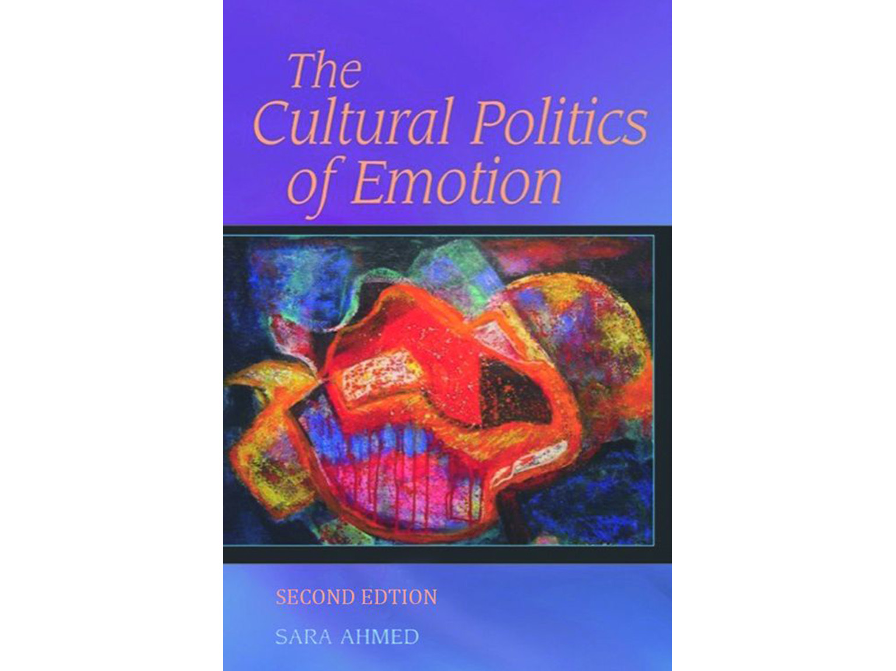



Emotions and Society: Preliminary Remarks
The complex nature of emotions as factors that play a key role (an explanatory one) in all social phenomena.
How can emotions help us interpret and understand contemporary sociological and political phenomena?
How do emotions highlight the link between affective dynamics that unfold at the micro-level and their broader implications that solidify at the macro-level?
How do emotions intersect new forms of communication and new types of public sphere?
These questions will be addressed by contextualising the sociological and political relevance of emotions in different empirical contexts and research areas (Pratesi 2018, 2022, 2023, 2024, 2026).

Slide 4

The sociological and political relevance of emotions
Emotions such as resentment, fear, anxiety, a feeling of uncertainty, or a sense of loss do not constitute a mere epiphenomenon of the democratic crisis, but rather one of the principal ways through which this crisis is experienced, politically mobilised, and theoretically explained.
Political leaders and parties, social movements, and media strategically use emotions to capture attention, influence public opinion, gather consensus, and build symbolic boundaries between insiders and outsiders (Ahmed 2004, Barbalet 2001, Demertzis et al. 2022, Clarke et al. 2006, Hochschild 2024, Kinnvall 2013, Marcus 2000, Martuccelli 2016, Massumi 2015).
Emotions are not only used by political and institutional actors to reach their goals, but are also mobilised by social movements, citizens, and grassroots organisations to influence political choices (Goodwin et al. 2001, Jasper 2006, Pratesi 2026).
What is new about that?

Slide 5
Towards New Theoretical and Empirical Developments
New conceptual and methodological tools are needed.
In is not (merely) a question of studying the relationship between emotions and politics, but rather a matter of grasping “the politics of emotions” (Ahmed 2004).
This means, for example:
Rediscovering the contribution of classical theoretical knowledge and bringing it into dialogue with current critical analyses (Cerulo and Scribano 2021).
Trying to understand the perspective of those who are different from us (Hochschild 2018, 2024).
Embracing the ambivalent nature of emotions as a theoretical and political opportunity.
Looking at the marginal/liminal spaces as sites or resistance (hooks 1990, Unger 2000, Sennett 2011, Sharma 2013, Pratesi 2022).
Highlighting the importance of relational, emotional, and micro-situated dynamics of social change (Pratesi 2018, 2023a, 2026).
Daring to go beyond disciplinary boundaries and experiment interdisciplinary contaminations (Pratesi 2022, 2026).

Slide 6

Concluding Thoughts:
Promising Directions for the Sociology of Emotions
We live in extremely interesting times, full of risks but also rich in opportunities for positive social change (Pratesi 2023, 2026).
The micropolitics of emotions (Ahmed 2004) create and shape the relationship between different social actors and groups, between insiders and outsiders, and between individuals and society.
In this context, using the interpretative lenses of emotion theories can help us provide conceptually more accurate and politically more fruitful analyses, but also review our theoretical formulations and raise questions we had not anticipated.
All this will have a better chance to happen if we open a real dialogue, currently lacking, between theorists of emotions belonging to different theoretical traditions and different disciplinary fields.

Slide 7

Molte grazie!
Thank you for your attention!

Slide 8

References
Ahmed, S. (2004). The Cultural Politics of Emotion, New York, Routledge.
Ahmed, S. (2010). The promise of happiness, Durham, Duke University Press.
Anderson, B. (2009). Affective atmospheres. Emotion, space and society, 2(2), 77-81.
Barbalet, J. M. (2001). Emotion, Social Theory, and Social Structure. A Macrosociological Approach, Cambridge, Cambridge University Press.
Bauman, Z., Donskis, L. (2013). Moral blindness: The loss of sensitivity in liquid modernity, Cambridge, Polity.
Cerulo, M. (2015). The Use of Emotions in Italian Politics: between the Creation of Leadership and the Construction of Consensus, International Journal of Novel Research in Humanity and Social Sciences, 2(5), 27-35.
Cerulo, M., Scribano, A. (eds.) (2021). The emotions in the classics of sociology: A study in social theory, New York, Routledge.
Clarke, S., Hoggett, P., Thompson, S. (eds.) (2006). Emotion, politics and society, New York, Palgrave Macmillan.
Clément M., Sangar E. (2018). Introduction: Methodological Challenges and Opportunities for the Study of Emotions, in Clément, M., Sangar, E. (eds.), Researching Emotions in International Relations, London, Palgrave Macmillan, 1-29.
Cossarini, P., Vallespín, F. (eds.) (2019). Populism and passions: Democratic legitimacy after austerity, New York, Routledge.
Delli Carpini, M.X. (2018). Alternative Facts: Donald Trump and the Emergence of a New U.S. Media Regime, in Papacharissi, Z., Boczkowski, P. (eds.), Trump and the Media, Cambridge, MA, MIT Press.
Demertzis, N. (2013). Emotions in politics: the affect dimension in political tension, London, Palgrave Macmillan.
Fitzi, G. (2021). Il substrato emotivo della modernità, Società Mutamento Politica, 12(24), 35-44.
Flam, H. (2015). Introduction: Methods of exploring emotions. In Methods of exploring emotions. Routledge, 1-22.
Gregg, M., Seigworth, G.J. (eds.) (2010). The affect theory reader, Durham, Duke University Press.
Hochschild, A.R. (2016). The ecstatic edge of politics: Sociology and Donald Trump, Contemporary Sociology, 45(6), 683-689
Hochschild, A.R. (2018). Strangers in Their Own Land: Anger and Mourning on the American Right, New York, The New Press.
Hochschild, A. R. (2024). Stolen pride: Loss, shame, and the rise of the right. The New Press.
hooks, b. (2000). All about love: New visions. William Morrow.
Hutchison, E., & Bleiker, R. (2014). Theorizing emotions in world politics. International Theory, 6(3), 491–514. https://doi.org/10.1017/S1752971914000232
Jasper, J. M. (2006). Emotions and the Microfoundations of Politics: Rethinking Ends and Means, in: Clarke, S., Hoggett, P., Thompson, S. (eds.), Emotion, Politics and Society, London, Palgrave Macmillan, 14-30.
Kemmer, L., Peters, C.H., Weber, V., Anderson, B., Mühlhoff, R. (2019). On right-wing movements, spheres, and resonances: an interview with Ben Anderson and Rainer Mühlhoff, Distinktion: Journal of Social Theory, 20:1, 25-41.
Kinnvall, C. (2013). Trauma and the Politics of Fear: Europe at the Crossroads, in: Demertzis, N. (ed.), Emotions in Politics, London, Palgrave Macmillan, 143-166.

Slide 9
References
Marcus, G.E. (2000). Emotions in politics, Annual review of political science, 3(1), 221-250.
Martuccelli, D. (2016). L’affectivité implicative et la vie en société, Quaderni di teoria sociale, 1, 9-28.
Massumi, B. (2015). Politics of affect, Cambridge, Polity Press.
Mishra, P. (2017). Age of anger: A history of the present, New York, Macmillan.
Mühlhoff, R. (2015). Affective resonance and social interaction, Phenomenology and the Cognitive Sciences, 14(4), 1001-1019.
Mühlhoff, R. (2019). Affective disposition, in Slaby, J., von Scheve, C. (eds.), Affective societies: Key concepts, New York, Routledge, 119-130.
Pratesi, A. (2018). Doing Care, Doing Citizenship. Towards a Micro-situated and Emotion- based Model of Social Inclusion, London, Palgrave Macmillan, Springer.
Pratesi, A. (2019). Review of Wahl-Jorgensen ‘Emotions, Media and Politics’, 2019, Cambridge, Polity Press, in: Cambio. Rivista sulle trasformazioni sociali. 9, 17, 139-142. ISSN online 2239-1118.
Pratesi, A. (2021). Ain’t I family? Transnational acts of family and social change, in Overcoming Family Boundaries. The promises and situatedness of the family practices perspective, Special Issue, Rassegna Italiana di Sociologia, 4 (12), 67-84.
Pratesi, A. (2022). The ‘Edge Effect’: Unfolding the Phenomenological Potential of Citizenship through Interdisciplinary and Emotion-Based Approaches. In Kleinschmidt, Natarajan, Neuburger, Peeck-Ho, Schröder, Sielert, Supik (eds.), Gender, Race and Inclusive Citizenship. Dialogues about Acts and Regimes of Belonging. Wiesbaden: Springer. ISBN: 978-3-658-36390-1, 93-117. online access
Pratesi, A. (2023). Six Memos for the Current Time. Rethinking six contemporary sociological matters in light of the emotional dynamics shaping them. CAMBIO, vol. 12, 109-123, ISSN:2239-1118. online access
Pratesi, A. (2023a). Emotions and Social change. Rethinking the theoretical relevance of emotions in light of emerging social and political phenomena. Sociologia Italiana, AIS Journal of Sociology, Egea-Bocconi Ed., Milano. ISSN 2281-2652, ISSNe 2611-5255, 9-29. online access
Pratesi, A. (2026). Emotions and Social Change. Theoretical and Empirical Perspectives. Palgrave McMilla, Springer.
Qi, X. (2024). Emotion in and through crisis. The British Journal of Sociology, 75(5), 908-921.
Sennett, R. (2011). The foreigner, Burneside, Kendal, Notting Hill Editions.
Sharma, M. (2013). The Liminality of Contemporary Culture, Bodhi: An Interdisciplinary Journal, 6, 109-119.
Scheff, T.J. (2019). The Origins of World War II: Hitler’s Appeal to the Germans, in Bloody Revenge, New York, Routledge, 105-124.
Schneider, R. A. (2023). The Return of Resentment, Chicago, University of Chicago Press.
Tomelleri, S. (2004). La società del risentimento, Roma, Meltemi Editore.
Turnaturi, G. (1995). La sociologia delle emozioni, Milano, Anabasi.
Turner, J. H., & Stets, J. E. (2005). The sociology of emotions. Cambridge University Press.
Turner, J. H., & Stets, J. E. (2006). Sociological theories of human emotions. Annual Review Sociology, 32(1), 25-52.

Slide 10
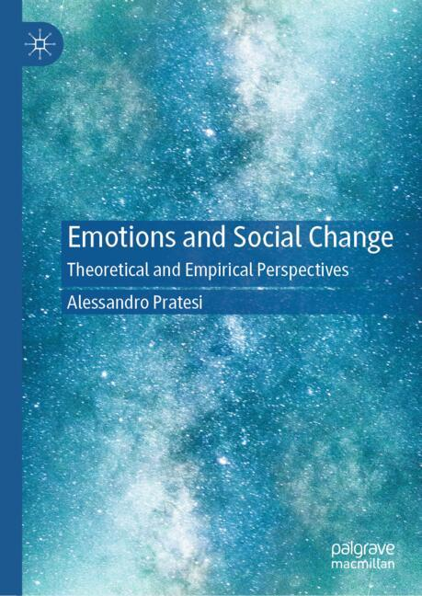
Emotions and Social Change
Overview
Clarifies how emotions shape societal challenges, politics, and offer insights for policy-making and social issues.
Develops an interdisciplinary view of emotions as a dynamic phenomenon, setting an agenda for future studies.
Explores early and recent advances in the Sociology of Emotions as a tool to understand contemporary societies.
About this book
The book illustrates the theoretical relevance of emotions to analyse and interpret contemporary events and societies. Emotions explain social phenomena while providing critical and analytical tools to challenge dominant or conventional interpretations of them. Drawing on examples of empirical research on emotions, it examines the long-standing sociological significance of emotions, some of the most recent theoretical and methodological advances, and the importance of fruitful interdisciplinary contaminations.
https://link.springer.com/book/9783032250575

