Slide 1
Enhancing design through system level simulations at GE Oil&Gas
Stefano Rossin
Consulting Engineer
Plant Design and Systems Engineering
GE Oil&Gas

Slide 2
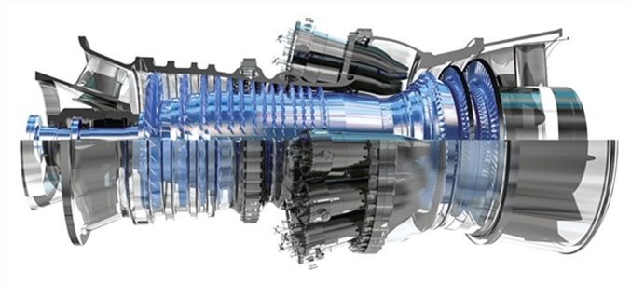
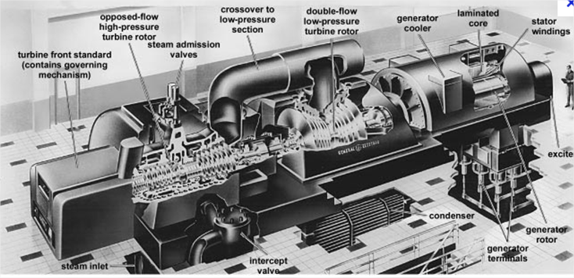
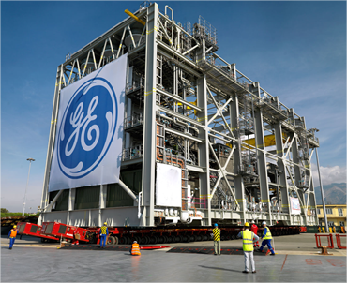
What business are we referring to?
Auxiliary Systems
Gas Turbines
Steam Turbines
Centrifugal compressors
Power generation plants
Compression system for Oil & Gas extraction (LNG plants, reinjection, pipeline applications, etc..)

Slide 3
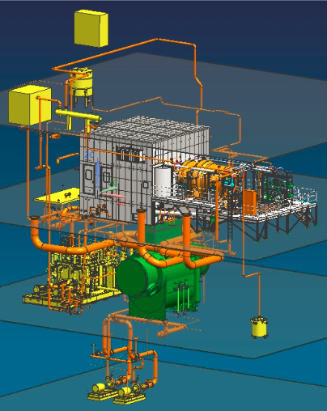
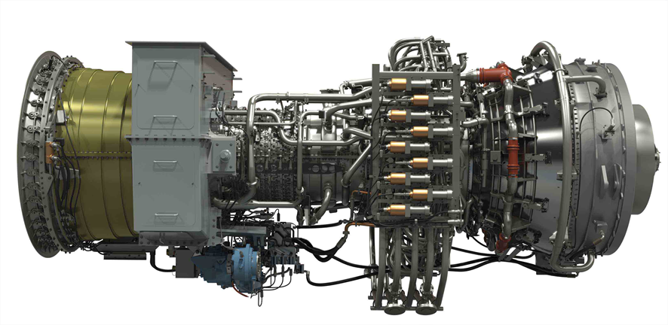
Auxiliary systems
Lubrication systems
Hot air bleeding
Ventilation
Cooling water systems
Dry gas sealing (for Centrif. Comp.)
Liquid fuel atomizing systems
Fuel gas manifold and distribution system
Complex Purging systems at fuel exchange on dual fuel machines

Slide 4
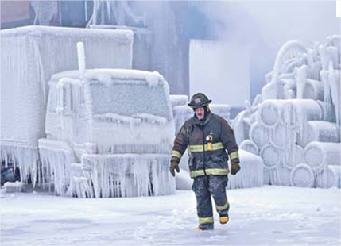
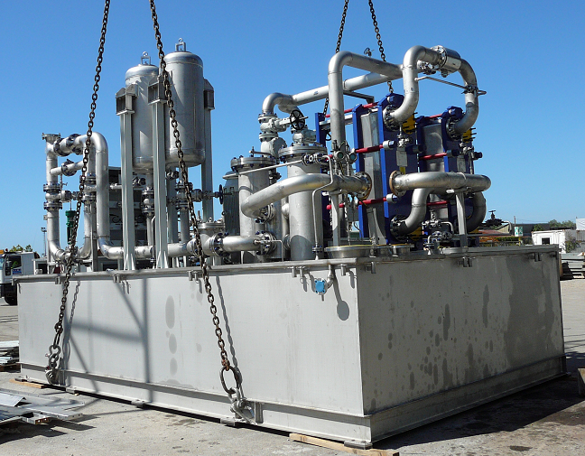
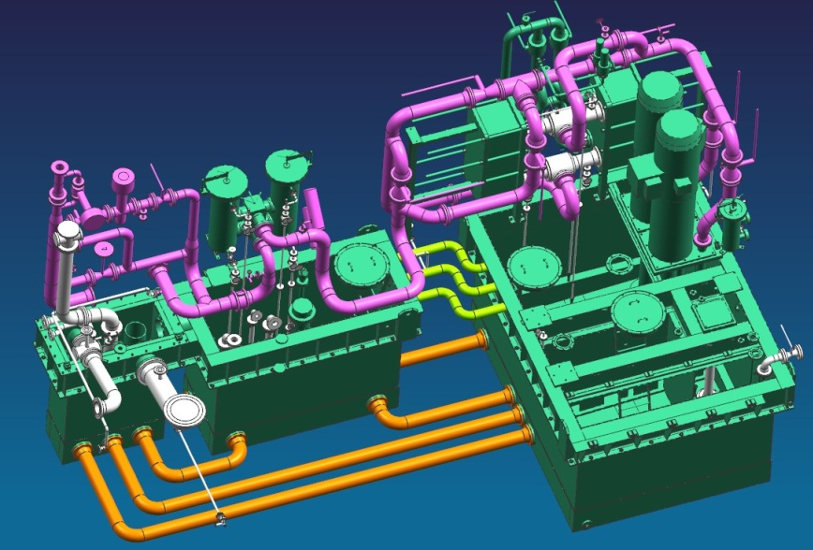
Lube Oil Consoles for extreme environments
Oil & Gas plants are often:
-in remote locations
-operating unattended
-subjected to extreme environmental conditions (Storms, Low temperatures, heavy rains, etc…)

Slide 5
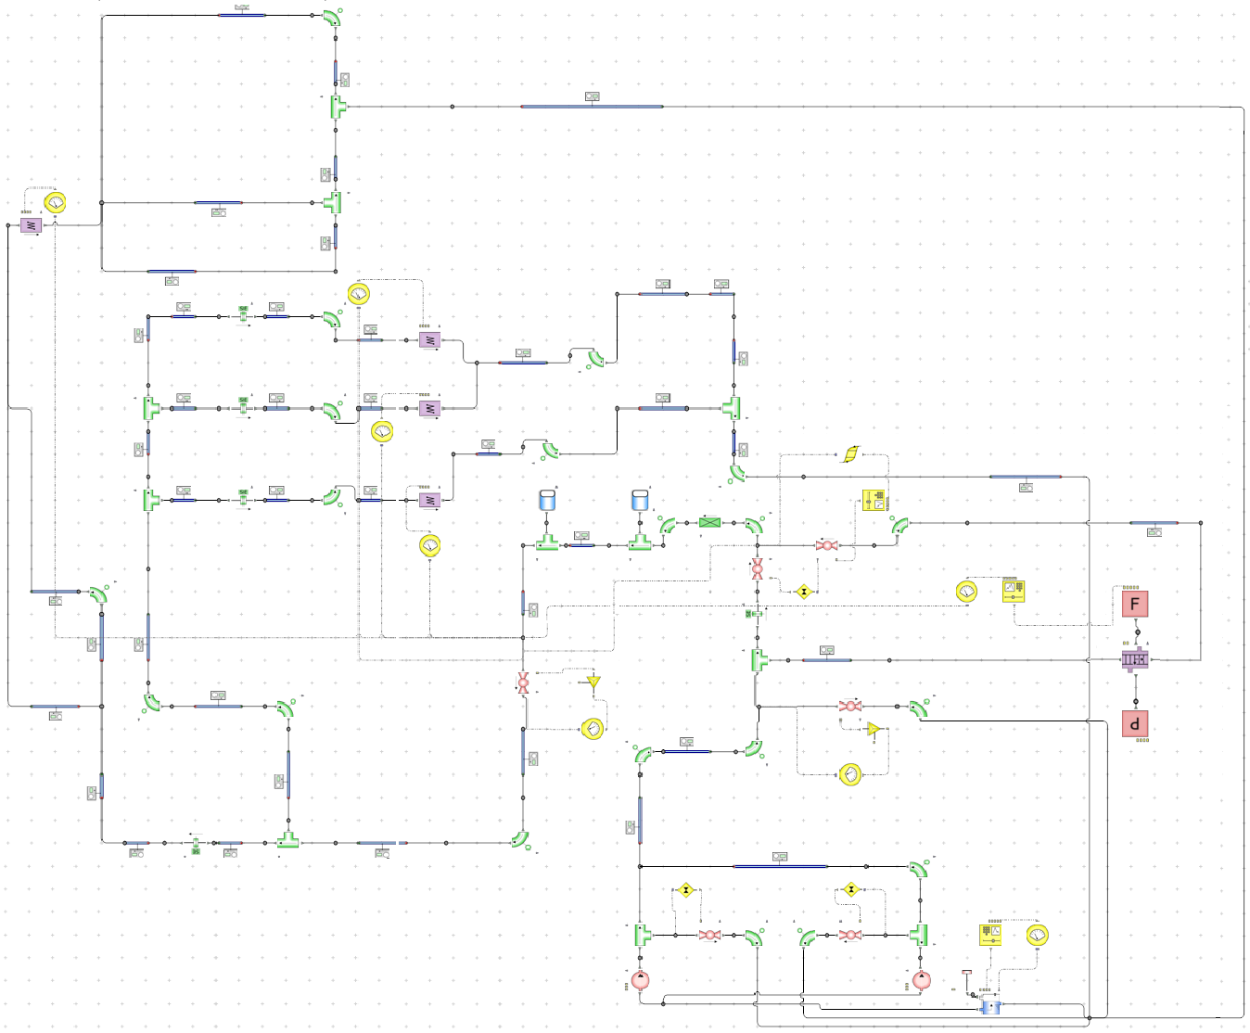
What challenges do we have?
Scope
Avoid insulation and heat tracing at low ambient temp. (-40 ÷ -5°C)
20÷40 k$ costs reduction for heat tracing and thermal insulation removal
Easy maintenance
Better leakage detection
EM
CECO
TCV
Cooler
Challenges
Oil Viscosity (Very high at low temp)
Full oil recycling (tank temp change Vs. time)
Controllers for PCV’s, TVC, PSV, Oil Tank Heaters and Machine Heat Rejection
Full Heat Transfer
Safety valve
PCV’s
Oil Tank
Volumetric Pump

Slide 6
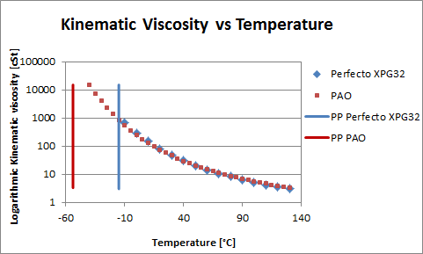
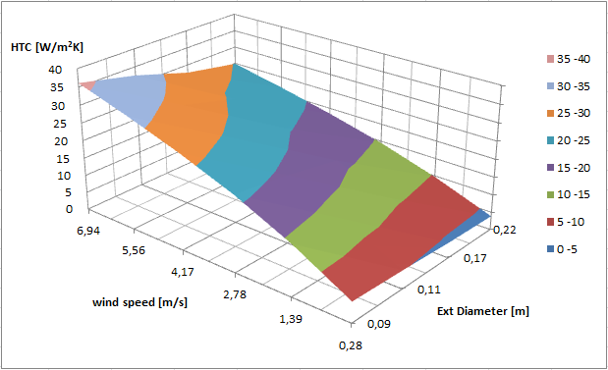
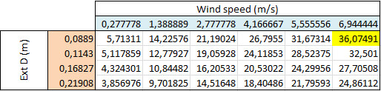
Pipe External HTC and Oil Viscosity
Viscosity comparison between different oils
Pour temperature may vary from -12°C to -55°C on the most performing oils
External HTC computed varying wind speed (from 1 km/h up to 25 km/h, 16 km/h according to API614) and pipes external diameter (from 3 to 8 inches).
-40°C
Maximum External HTC value (~ 36 W/m2K) is reached for maximum wind speed and minimum pipe diameter .

Slide 7
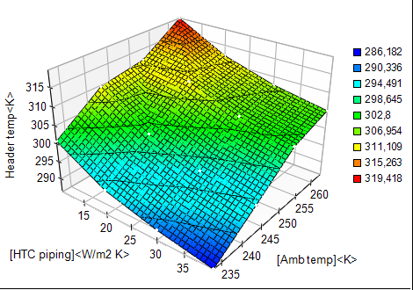
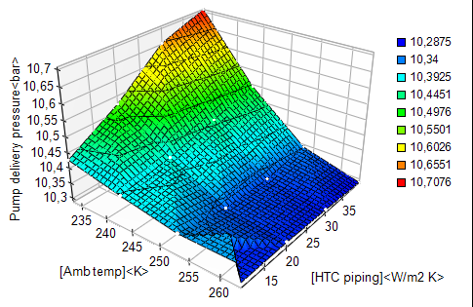
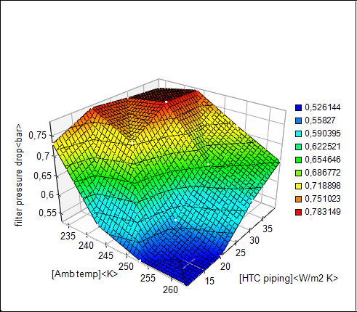
Parametric Study – Steady State runs
Header Temp
Header Pressure
Oil pressure below the acceptable limit of 12.5 barg
Parametric Investigation
Sweep HTC values from 10 to 40 W/m²K
External Temperature varying from -10°C down to -40°C
Filter pressure drop ~0,65 bar @ -20°C with HTC 25 W/m2K
Findings
Pump delivery pressure below PSV set poin but close to the limits
Filter pressure drop reaches almost 0.8 barg during normal run ... Dirty filters limit (machine trip) is 1 barg

Slide 8
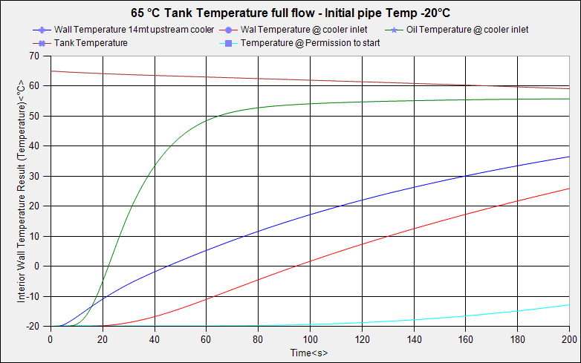
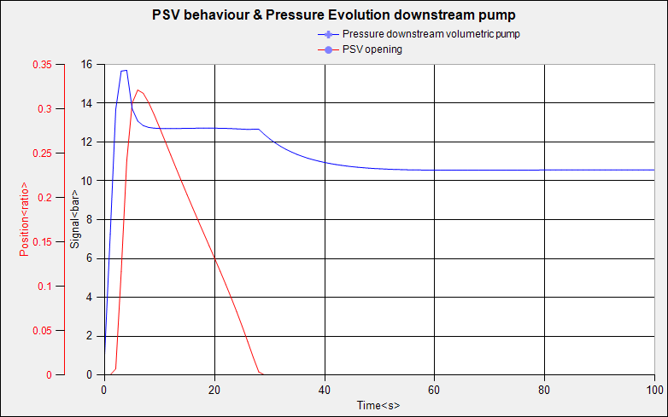
Pump Startup - Evolution through time
Tank temperature reducing due to cold oil entering the tank
Pipe wall temperature slowly increasing due to heat capacity of steel pipes
Circuit is assumed full of oil as if no drainage was performed after machine shut down
Tank oil temperature assumed to be at nominal value (extremely favorable condition)
PSV switches open for the first 30 seconds

Slide 9
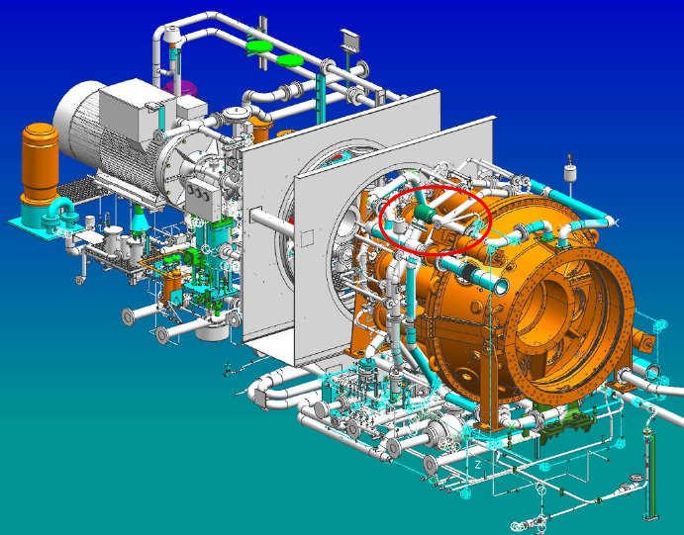
Extended operation for Gas Turbines
Extending the operating condition of a Gas turbine (i.e. reducing or increasing the power at a fixed rotational speed) under specified ambient temperatures my lead to unwanted situations

Slide 10
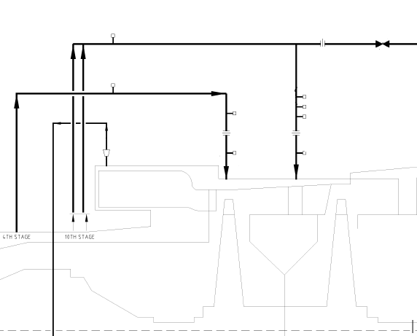
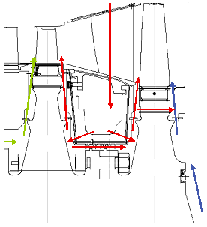
Wheel Space Cooling System
To avoid creeping phenomena GT wheels are cooled down by means of axial compressor air bleeding
Different air temp (axial compressor stage) are used to mitigate thermal gradient
High Temp Air
Low Temp Air
GT wheels
Cooling air from 10th compressor stage
Axial Comp
Cooling air from 4th compressor stage
Cooling air compressor discharge

Slide 11

Wheel Space Temperature Issue
At GT partial loads the 4th compressor stage pressure can fall below the wheel space pressure leading to a potential reverse flow causing the GT to trip due to high GT wheel space temperature
High Temp Air
LowTemp Air
GT wheels
Axial Comp

Slide 12
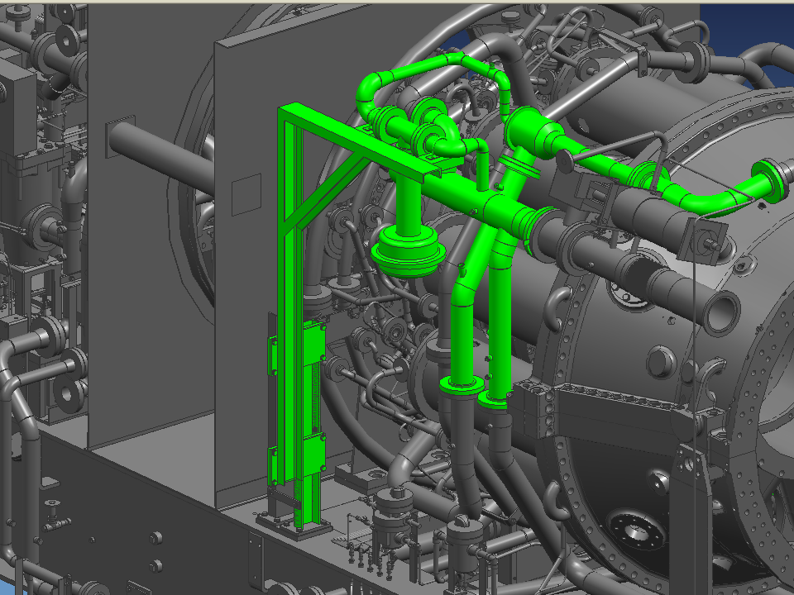
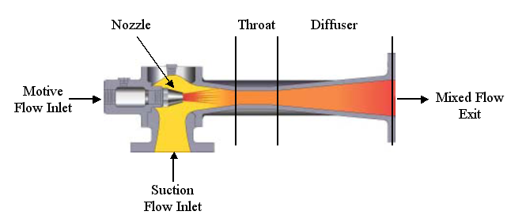
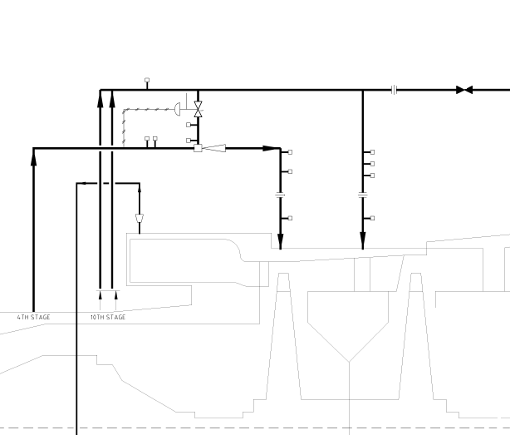
Wheel Space Cooling with Ejector
High Temp Air
Low Temp Air
GT wheels
Axial Comp
Ejector will become a passive component when 4th stage pressure is higher than wheel space pressure
Ejector switch off is controlled by dedicated shut off valve

Slide 13
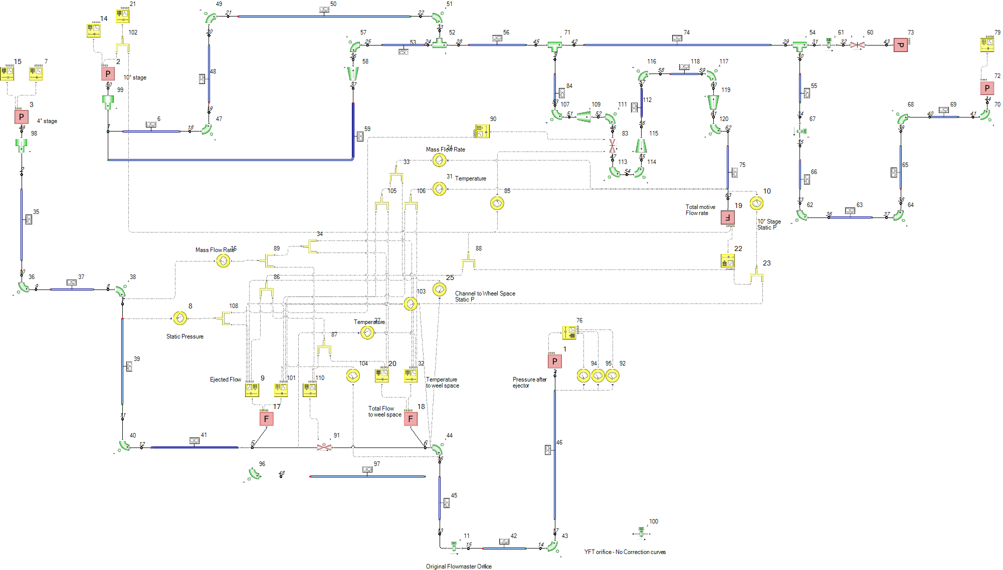
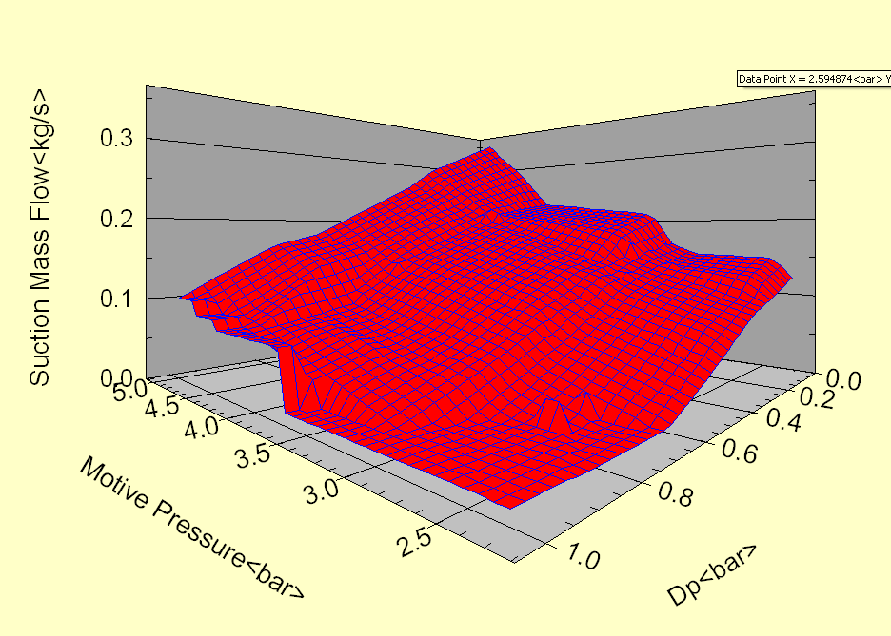
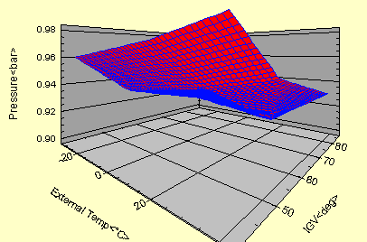
Fluid Network Model
Ejector component suction mass flow rate identified through motive pressure and total differential pressure … Experimental tests performed for the component characterization
4° & 10°
compressor Stage
10°
Stage discharge
Ejector
Wheel Space
Pressure

Slide 14
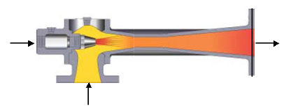
Ejector Network – Data Flow
10° stage Pressure & Temp
Motive flow from Ejector curve
Flow
GT Power
Amb Temp
Motive pressure from network iterations
Ejector Performance
Surface
Suction flow
Ejected pressure from network iterations
4° stage Pressure & Temp
Suction pressure from network iterations
Dp

Slide 15
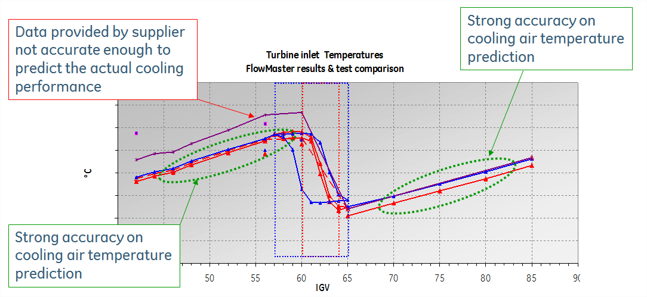
Ejector Performance Results
Several experimental tests carried out on the ejector component to compare performance surfaces with the one provided by the ejector supplier
Comparison with measurements during a GT string test highlights a potential mismatch with the supplier ejector performance (30% deviation)

Slide 16
Conclusions
FLOWMASTER is widly used in GE O&G for many different applications for both compressible and incompressible domains
It allows to carry out a sensitivity analysis to best dig into existing issues, virtually validate new design and explore the domani space of current known configurations
It has proven good correspondance with experimental tests on several applications on both compressible and incompressible fluids
Some limitations have been detected in terms of speed for mathlab/Flowmaster cosimulations and transient analysis on compressible networks
Future work will focus on custom interfaces and batch run

Slide 17




Notes:
This paper is focused on GE Oil&Gas gas turbine auxiliary systems with the aim of providing a reliability prediction in the early stages of product development, in particular at “P&ID definition” stage (P&ID: sketch of thermal-hydraulic systems): reliability parameters can help design engineering to:
Reduce time for improvement
Reduce time-delivery
Compare multiple configurations
Validate design choices
Achieve reliability target
Garantee availability performance
Reliability assessment is achieved with a dedicated tool named RBDesigner that semi-automatically generates a Reliability Block Diagram (RBD) starting from the P&ID schemes and provides the most important reliability parameters such as reliability vs. time, hazard rate vs. time and MTTF.

